Slide 1
Interpersonal Communication at the Workplace HS513

Slide 2
Outline
What is Interpersonal Communication?
Importance
Types
Problem Solving
Team work

Slide 3

What is interpersonal communication?

Slide 4

Interpersonal communication is the process of exchange of information, ideas and feelings between two or more people through verbal or non-verbal methods. It often includes face-to-face exchange of information, in a form of voice, facial expressions, body language and gestures. The level of one’s interpersonal communication skills is measured through the effectiveness of transferring messages to others
Commonly used interpersonal communication within an organization include daily internal employee communication, client meetings, employee performance reviews and project discussions.
In addition, online conversations today make a large portion of employees’ interpersonal communication in the workplace.

Slide 5
Importance
On a scale from 1 to 5, managers rate the importance of having good interpersonal skills at 4.37, just below the ‘ability to work in teams.
There are many reasons why they are so valued; even though most workplace business is now conducted through online communication channels, it is still necessary to possess verbal skills in order to work effectively with your colleagues and bosses.

Slide 6
Problem Solving
Ability to handle unexpected situations at the workplace, complex business challenges
Interpersonal communication skills are necessary because they allow people to discuss problems and weigh the pros and cons of alternatives before coming up with the final solution.
Asking questions
Gathering Information
Brainstorming

Slide 7
Alignment with business Goals
When managers and leaders are unable to clearly communicate tasks, workers can quickly become frustrated and disconnected with the business goals.
Employees: Managers do not give clear directions and goals
Proper online and offline communication
Right internal communication tools
Printed word
Broadcast messages
Face-to-face meetings: briefing on tasks and situations
Resources- intranet, social media, internal phone

Slide 8

Trust at the workplace
Be ready to earn it. ...
Be honest and transparent. ...
Listen more intently and deliberately. ...
Consistently model trustworthy behavior. ...
Embrace company-wide accountability practices. ...
Extend empathy and humanity to employees. ...
Solicit feedback and take action on suggestions.
Trust is crucial in the workplace for several reasons:
it fosters ethical decision-making, promotes loyalty, and increases the willingness to remain with a company.
plays a vital role in reducing stress levels and hostility in the work environment.
helps overcome resistance to change.
essential for a healthy and productive work environment.

Slide 9

Conflict Management
Conflict happens
Helps resolve conflict in a calm and timely manner
Misunderstandings result from mistranslated messages, or from gaps or extraneous noise in the message.
Successful transmission requires clear channels of communication and shared codes

Slide 10
Responses
Being unable to recognise or respond to issues that are important to the other person Responding in an angry, resentful or hurtful way or using blame Withdrawing love, rejecting, isolating or shaming Avoiding and fearing conflict Expecting conflict to end badly Trying to “win” or always having to get your own way Always surrendering to avoid or deny conflict Using fear, power or influence
Recognising and responding to issues that are important to the other person
A desire to forgive and forget
Seeking to compromise rather than to punish
A belief that resolution can be found
Remaining open to and respectful of the other person’s opinion while being authentic, asserting your own views

Slide 11
Role of communication in Conflict Management
Be very clear and straightforward about your expectations – don’t expect people to simply understand your wishes.
If communicating with a group of people don’t merely depend on verbal communication – use email to keep a record and ensure everyone is in the loop. And never ignore or neglect certain members.
Be aware of the pitch and tone of your voice – try to remain polite and be a good listener.
Don’t assume things or overreact to petty issues – and remember everyone has the right to express their views and be listened to so avoid interrupting.

Slide 12
Techniques for Conflict Resolution
The Defusing Technique: Try to find some value in the opposing point of view. This doesn’t mean compromising your principles but validating the other’s position so that you can reach resolution.
Empathy: Try to put yourself into the other person’s shoes and see the situation from their point of view.
Exploration: Ask questions to understand the other person’s opinions or feelings.
Use “I” Statements: Admit and accept your thoughts and feelings instead of blaming the other person. This will decrease the chance of the other person becoming defensive.
Stroking: Be respectful and identify some positives about the other person.

Slide 13
Communication Styles Counter-Productive to conflict resolution
Criticism – personal attacks and put downs.
Contempt – lack of respect, such as eye rolling, name-calling or sarcasm.
Defensiveness – this escalates the conflict as we stop listening to the other’s viewpoint
Stonewalling – refusing to engage in discussion. In other words, the “silent treatment”.
Ordering
Warning
Preaching
Advising
Lecturing
Agreeing, just to keep the peace
Ridiculing

Slide 14
Some tips
Be clear, precise and straightforward
Be transparent
Don’t rely just on one medium – verbal, emails – use a combination
All members must come together on a common platform
Control the pitch and tone of your voice
Master the art of writing emails
Keep control over your emotions
Don’t assume or react on petty issues

Slide 15
Crisis management and communication
A crisis management plan — also known as a crisis communication plan — is a set of guidelines used to prepare a business for an emergency or unexpected event. These plans include steps to take when a crisis first emerges, how to communicate with the public, and how to prevent the issue from occurring again.
A crisis communication plan helps guarantee a quick release of information, as well as a consistent message on all company platforms during a time of crisis.
Five Rs – regret, responsibility, resolution, restitution and reform
5 Cs of crisis communications: Concern, Commitment, Competency, Clarity, and Confidence

Slide 16
Some examples
Southwest has consistently been one of the safest airlines in the world. However, that doesn't mean the company doesn't experience accidents.
On Flight 1380, an engine malfunction resulted in the death of a passenger and was recorded as the company's first in-flight fatality. The company's CEO, Gary Kelly, immediately responded to the situation by offering a sincere, heartfelt apology to the victim's family. He then pulled all advertising from their social media channels and made personal phone calls to passengers offering support and counseling resources.
Why This Was Effective: While it's hard to consider grim crises like these, they do occur and impact businesses. Even though Southwest had never encountered an accident like this before, the CEO was prepared for this situation and demonstrated genuine remorse both through his words and his company's actions.

Slide 17
Amazon faced criticism in December 2021 after a tornado ravaged one of its warehouses in Edwardsville, Illinois. Six people died in the warehouse collapse in Illinois as a series of tornadoes ripped through parts of Tennessee, Kentucky, and Arkansas.
Once reports surfaced of Amazon warehouse workers allegedly being forced to continue working through tornado warnings, the company's health and safety guidelines quickly came under scrutiny.
Amazon's first misstep was a delayed public response. CEO Jeff Bezos took nearly 24 hours to respond to the warehouse collapse.
"The news from Edwardsville is tragic. We're heartbroken over the loss of our teammates there, and our thoughts and prayers are with their families and loved ones," Bezos tweeted. "All of Edwardsville should know that the Amazon team is committed to supporting them and will be by their side through this crisis. We extend our fullest gratitude to all the incredible first responders who have worked so tirelessly at the site."
Bezos was quickly lambasted across social media, with many suggesting that his statement was insincere.
What Could've Been Better: When such a tragic loss of life happens, it's best to come out with a statement that expresses empathy sooner rather than later. Bezos' reply came across as insincere in part because it was delayed. The CEO had been steadily tweeting and posting about the landing of Blue Origin throughout the day, so by the time he commented on the tornado tragedy, it seemed like an afterthought.
https://blog.hubspot.com/service/crisis-communication-plan#:~:text=A%20crisis%20management%20plan%20%E2%80%94%20also,the%20issue%20from%20occurring%20again.

Slide 18
Emotional intelligence and communication
Research shows successful communication and negotiation are closely linked to high levels of EQ.
People with low levels of EQ may react defensively in stressful situations and cause conflict.
Individuals with higher EQ have refined the skills needed to be able to communicate effectively without confrontation or anger.
Employees with higher EQ are more likely to approach conflict resolution collaboratively.
They will work with other employees to reach a mutually acceptable outcome.

Slide 19
Models of EI
Ability Model
developed by Peter Saloveyand John Mayer
focuses on the individual's ability to process emotional information and use it to navigate the social environment.
Trait Model
developed by Konstantin Vasily Petrides
"encompasses behavioural dispositions and self-perceived abilities and is measured through self-report"
Mixed Model
proposed by Daniel Goleman
an array of skills and characteristics that drive leadership performance

Slide 20
Ability Model
Perceiving emotions – the ability to detect and decipher emotions in faces, pictures, voices, and cultural artifacts—including the ability to identify one's own emotions. Perceiving emotions represents a basic aspect of emotional intelligence, as it makes all other processing of emotional information possible.
Using emotions – the ability to harness emotions to facilitate various cognitive activities, such as thinking and problem solving. The emotionally intelligent person can capitalize fully upon his or her changing moods in order to best fit the task at hand.
Understanding emotions – the ability to comprehend emotion language and to appreciate complicated relationships among emotions. For example, understanding emotions encompasses the ability to be sensitive to slight variations between emotions, and the ability to recognize and describe how emotions evolve over time.
Managing emotions – the ability to regulate emotions in both ourselves and in others. Therefore, the emotionally intelligent person can harness emotions, even negative ones, and manage them to achieve intended goals.

Slide 21
Mixed Model
Self-awareness – the ability to know one's emotions, strengths, weaknesses, drives, values and goals and recognize their impact on others while using gut feelings to guide decisions.
Self-regulation – involves controlling or redirecting one's disruptive emotions and impulses and adapting to changing circumstances.
Social skill – managing relationships to move people in the desired direction
Empathy - considering other people's feelings especially when making decision
Motivation - being driven to achieve for the sake of achievement.

Slide 22
Communication and Effective leadership
Communication style plays a crucial role in exhibiting leadership.
There are 9 common communication styles: Experiencing, Imagining, Reflecting, Analyzing, Thinking, Deciding, Acting, Initiating, and Balancing.

Slide 23
“Leadership communication involves all of the ways the leaders of an organization deliver messages internally and externally that build and reinforce its culture/core values, vision, mission, and strategic priorities.
It includes both what they communicate and how they communicate it.
There is an inherent inspirational nature to it — largely because of the leader’s position of power and influence. This means a leader’s communication has the ability to inspire either positive or negative attitudes, behavior, and performance.” - Dawn Cone, Consulting Solutions

Slide 24
Leadership Styles
Pioneering: Pioneering leaders tend to be charming, bold, and passionate. At times they may come across as overconfident or impulsive, but they’re great at encouraging others to try new things.
Energizing: Energizing leaders use their popularity and energy to motivate those around them. They know that excitement around a shared goal can drive people to succeed. At times, they may seem unorganized or erratic because they move at such a fast pace.
Affirming: Affirming leaders are very supportive and do their best to create a positive environment where everyone is happy. This behavior can also cause this leadership type to beat around the bush or avoid giving hard or constructive feedback.
Inclusive: Inclusive leaders are big on collaboration and work hard to accommodate the needs of everyone around them. Sometimes their inclusive behavior can cause them to let others take advantage of how willing they are to support.
Humble: Humble leaders are reliable, modest, and fair. They succeed with the mantra “slow and steady wins the race” but can also be overly cautious and afraid to take risks.
Deliberate: Deliberate leaders are very analytic, disciplined, and organized. They often display perfectionist tendencies and can forget to be empathetic towards others in their effort to achieve high standards.
Resolute: Resolute leaders aren’t afraid to question the norm or do things differently in order to achieve better results. Because they’re always open to questioning questioning how things are done, they can sometimes come across as negative or pessimistic.
Commanding: Commanding leaders know what they want and how to get there. They’re great at sending a powerful message of action to motivate their teams, but can also come across as bossy or demanding if they don’t make a conscious effort to focus on team happiness.

Slide 25
Team Building and Communication
there is an increased risk of conflict, tension, and misunderstandings in the workplace without good communication.
Good Communication is the foundation of a healthy culture and properly functioning team.
Excellent team communication can lead to better work relationships and role clarity, increasing both employee satisfaction and engagement.
Efficient
Problem Solving
Conflict Resolution

Slide 26
TeamWork Communication Formats and Channels
Verbal
Phone calls, video calls, 1:1 meeting, water break meetings
Written
Email, team chats, documentation

Slide 27
Teamwork communication styles
Passive
Nonconfrontational, falsely agreeable,
Aggressive
Loudest,
Assertive
utilize open, genuine, and direct communication in their interactions, take ownership of their feelings, actions
Passive-Aggressive
may carry feelings of resentment, difficulties in admitting to anger,
healthy, respectful, and honest; it is thought to be the most effective form of communication and the ideal to strive for in each interaction.
may manifest in gossip, silent treatment,
under-their breath comments,
pretend everything is fine
having difficulties setting boundaries and saying no as a result
Struggle with listening to others,
demand respect
speaking over others and controlling the narrative during a discussion

Slide 28
SMART goals
Efficient team – clear cut goals - SMART
If goals are Specific, the team understands what they are pursuing, and why;
If goals are Measurable, the team is able to track progress;
If goals are Attainable, the team pursues goals they have the power to reach;
If goals are Relevant, the team pursues an important cause;
If goals are Time-bound, the team has a clear target date.

Slide 29
Body Language and Interpersonal Communication Skills
Non verbal cues can be repeated and help in making verbal communication skills strong.
The non-verbal cues add as substitutes to the spoken language as expressions are enough to communicate at times.
Many a times non-verbal communication especially body language can compliment verbal communication and adds to the effectiveness of the communication. For example while saying thank you to someone if you fold your hands and smile it adds to the communication.
Non verbal communication also helps in emphasizing upon what is being said. If someone is patted on the back while being appreciated it adds value to spoken words and the receiver feels that the appreciation is genuine.
Body language never lies. If what you say is not what you mean, your body language may contradict your speech and the receiver may be doubtful of your words.

Slide 30
HandShakes
Always use the right hand
If you are carrying any object, transfer it to the left hand
Do not squeeze the other person’s hand
Appropriate time – neither too short nor too long
It is recommend to greet by saying hello, welcome and to start the conversation before you let go of the hand.

Slide 31
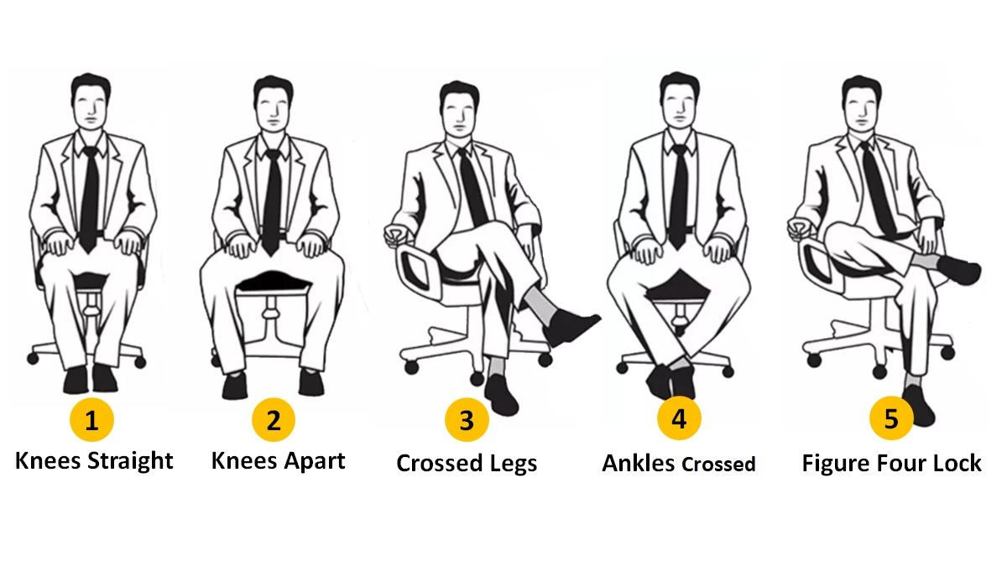
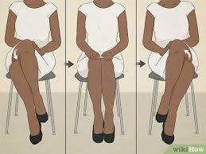
Postures
Different for men and women
Intelligent, Rational Thinkers, Punctual, Smart Workers, Cleanliness Lover, Honest but Reserved.
Self-centered, Arrogant, Judgmental, Short attention span, and quick to get bored
Artistic, Creative, Imaginative, Dreamer, Defensive or closed-off.
Elegant, Refined, Down-to-earth, Confident, Regal, Ambitious, Defensive
Confident, Dominating, Youthful, Secure, Content, Argumentative, Competitive

Slide 32
Career Progression and Communication
Effective communication is important to career success because leaders who build a culture of positive communication can help a business reach its goals with greater efficiency, produce satisfied workers and improve brand identity — all of which can translate to their own success.
Mitigating Conflict
Problem Solving
Self-Confidence and Respect
Collaboration
Persuasion
Diplomacy

Slide 33
Empathetic Communication
Understand and share the feelings of others
Lack of empathy: conflict, misdirection, loss of trust, loss of sales, rash decisions, tarnished reputation
Analyse your style
Use of non-verbal cues
Emotional Intelligence
Clarification vs assumption
Open mind vs judging
Use assertive communication
Practise active listening…..

Slide 34
Thank you
Stay tuned for Listening Skills……

